Slide 1

LECTURE 10: Object Oriented Design
Principles
Ivan Marsic
Rutgers University

Slide 2

Topics
SOLID Design Principles
  https://en.wikipedia.org/wiki/SOLID
Composition over inheritance (aka Composite reuse principle)
  https://en.wikipedia.org/wiki/Composition_over_inheritance
Don't Repeat Yourself - DRY
  https://en.wikipedia.org/wiki/Don%27t_repeat_yourself
Inversion of Control - IoC (aka Hollywood Principle)
  https://en.wikipedia.org/wiki/Inversion_of_control
You Aren't Gonna Need It - YAGNI
  https://en.wikipedia.org/wiki/You_aren%27t_gonna_need_it
Law of Demeter - LoD (aka Principle of Least Knowledge)
  https://en.wikipedia.org/wiki/Law_of_Demeter
Principle of Least Astonishment - PoLA
  https://en.wikipedia.org/wiki/Principle_of_least_astonishment
Minimum Viable Product - MVP
  http://en.wikipedia.org/wiki/Minimum_viable_product

Slide 3
SOLID Design Principles
Software inevitably changes/evolves over time (maintenance, upgrade)
Single responsibility principle (SRP)
  Every class should have only one reason to be changed
  If class "A" has two responsibilities, create new classes "B" and "C" to handle each responsibility in isolation, and then compose "A" out of "B" and "C"
Open/closed principle (OCP)
  Every class should be open for extension (derivative classes), but closed for modification (fixed interfaces)
  Put the system parts that are likely to change into implementations (i.e. concrete classes) and define interfaces around the parts that are unlikely to change (e.g. abstract base classes)
Liskov substitution principle (LSP)
  Every implementation of an interface needs to fully comply with the requirements of this interface (requirements determined by its clients!)
  Any algorithm that works on the interface, should continue to work for any substitute implementation
Interface segregation principle (ISP)
  Keep interfaces as small as possible, to avoid unnecessary dependencies
  Ideally, it should be possible to understand any part of the code in isolation, without needing to look up the rest of the system code
Dependency inversion principle (DIP)
  Instead of having concrete implementations communicate directly (and depend on each other), decouple them by formalizing their communication interface as an abstract interface based on the needs of the higher-level class

Slide 4
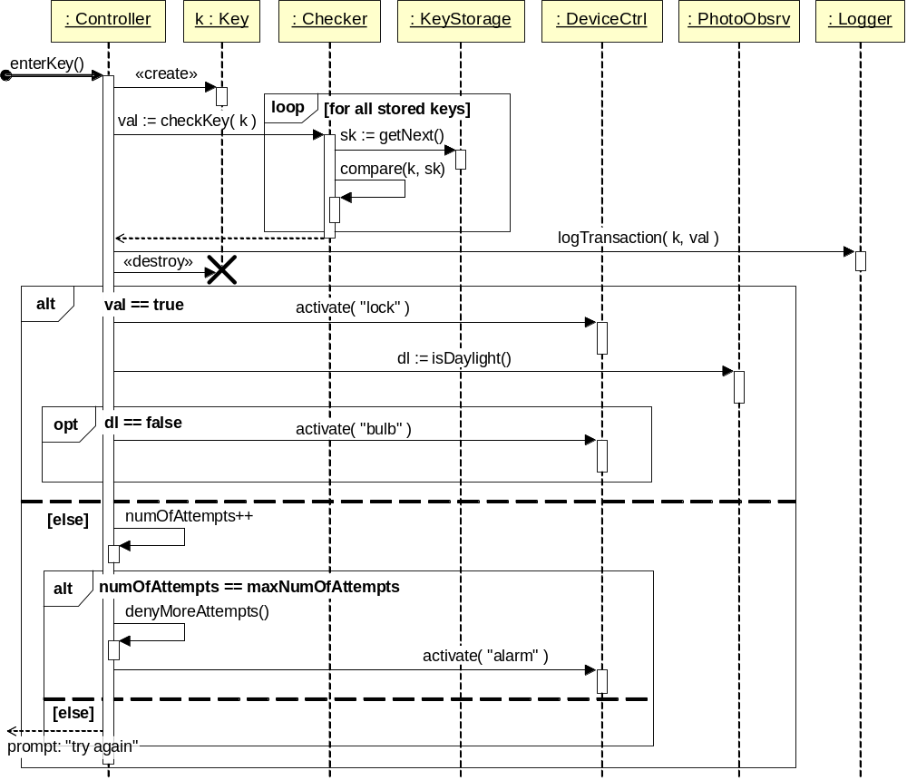
… is this a good design?
Unlock Use Case
Time
Notes:
We built an undue complexity into the Controller while striving to preserve high degree of specialization for all other objects. [[ Note: GUI aspects are treated separately. ]]

Slide 5
Class Diagram
PhotoSObsrv
+ isDaylight() : boolean
Key
– code_ : string
– timestamp_ : long
– doorLocation_ : string
1
KeyStorage
+ getNext() : Key
1..*
1
1
sensor
k
validKeys
1
Controller
# numOfAttemps_ : long
# maxNumOfAttempts_ : long
+ enterKey(k : Key)
– denyMoreAttempts()
1
KeyChecker
+ checkKey(k : Key) : boolean
– compare(k : Key, sk : Key) : boolean
checker
1..*
devCtrl
DeviceCtrl
# devStatuses_ : Vector
+ activate(dev : string) : boolean
+ deactivate(dev :string) : boolean
+ getStatus(dev : string) : Object
1
reader
KeyReader
+ acquireKey() : Key

Slide 6
Purpose of Design Principles
Principles are used to diagnose problems with designs
Patterns are used to address the problems

Slide 7
Examples of Software Change
What could change in the home access system: means of user authentication and the controlled devices. These sources of change are independent, so one should not affect the code for the other
Scenario #1: replace numeric-code based keys with magnetic card or RFID chip
  What part of the system needs to be replaced?
  What is the “interface” seen by the rest of the system that needs to remain invariant?
Scenario #2: same as above
  Policy for handling dictionary attacks becomes inadequate: what kind of attack can be mounted by an adversary in case of magnetic or RFID codes?
  What policy (or policies) are appropriate for this scenario?

Slide 8
Dependencies for
Ordinary Layered Style
User Authenticator
Arrival Manager
Policy Layer for
Safe Home Access
What is needed:
- User’s identifier (“key”)
- Set of valid keys
- Mechanism to validate the user’s key
depends-on
Key Descriptor
Key Validator
Valid Keys Storage
Mechanism Layer for
Safe Home Access
Device Controller
depends-on
Key Reader
File or Database
Utility Layer for
Safe Home Access
Device Driver
Note the dependencies from top to bottom
That is, higher-level modules depend on the lower-level modules
➔ Any changes in lower-level modules may propagate up to the higher levels

Slide 9
Need Inverted Dependencies
Low-level modules are more likely to change
High-level modules are more likely to remain stable: they implement the business policies, which is the purpose of the system
and is unlikely to change
Dependency Inversion Principle (DIP)

Slide 10
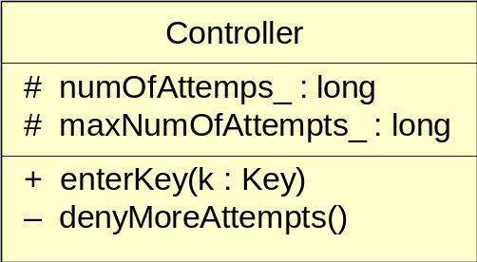
Example Business Policy
& Mechanism
IF key ∈ ValidKeys THEN disarm lock and turn lights on
ELSE
increment failed-attempts-counter
IF failed-attempts-counter equals maximum number allowed
THEN block further attempts and raise alarm

Slide 11
Safe Home Access Policy Level
Detailed statement of the problem:
  Read the numeric code typed-in by the user
  Validate the code, and
  Set the voltage high to disarm the lock, turn on the light
Abstract statement of the problem:
  Acquire the user code
  Validate the code, and
  Enable access and assist user’s arrival activties

Slide 12
Dependency Inversion Principle
Instead of high-level module (policy) depending on low-level module (mechanism/service/utility):
  High-level module defines its desired interface for the low-level service (i.e., high-level depends on itself-defined interface)
  Lower-level module depends on (implements) the interface defined by the high-level module
  ➔ Dependency inversion
  (from low to high, instead the opposite)

Slide 13
Dependency Inversion Pattern
Package diagram
Defined by policy-package owner
Policy Package
depends-on
(«uses»)
«interface»
PolicyServiceInterface
client : PolicyClass
developer A
depends-on
(«implements»)
Mechanism Package
server : PolicyServiceClass
developer B
Note the dependencies from bottom to top
Both Policy Class and Policy Service Class depend on Policy Service Interface
but the former uses (and defines) the interface and the latter implements the interface

Slide 14
Additional Object: Intruder Detector?
Based on an invalid key decides an intruder
However, the notion of a “dictionary attack” may not make sense for non-numeric keys, not acquired from a keypad
If the “key” is a magnetic-card code, it cannot be assumed that the user made a mistake and should be given another try
  If a key is transmitted wirelessly, it may be intercepted and reproduced
What if the “key” is user’s fingerprint or another biometric feature?
  A biometric identifier could be faked, although also user may have dirty or greasy fingers which would prevent correct fingerprint-based identification
  or user’s face may not be properly illuminated…
➔ Need a new intruder-detection mechanism …

Slide 15
Examples of Software Change
What could change in the home access system: means of user authentication and the controlled devices. These sources of change are independent, so one should not affect the code for the other
Scenario #1: replace numeric-code based keys with magnetic card or RFID chip
  What part of the system needs to be replaced?
  What is the “interface” seen by the rest of the system that needs to remain invariant?
Scenario #2: same as above
  Policy for handling dictionary attacks becomes inadequate: what kind of attack can be mounted by an adversary in case of magnetic or RFID codes?
  What policy (or policies) are appropriate for this scenario?

Slide 16
… where is the “interface” when the ID mechanism changes?
PhotoSObsrv
+ isDaylight() : boolean
Key
– code_ : string
– timestamp_ : long
– doorLocation_ : string
KeyStorage
+ getNext() : Key
sensor
k
validKeys
Controller
# numOfAttemps_ : long
# maxNumOfAttempts_ : long
+ enterKey(k : Key)
– denyMoreAttempts()
KeyChecker
+ checkKey(k : Key) : boolean
– compare(k : Key, sk : Key) : boolean
checker
devCtrl
DeviceCtrl
# devStatuses_ : Vector
+ activate(dev : string) : boolean
+ deactivate(dev :string) : boolean
+ getStatus(dev : string) : Object
reader
KeyReader
+ acquireKey() : Key

Slide 17
Dependency Inversion Pattern
Package diagram
Defined by policy-package owner
(developer A)
Policy Package
depends-on
(«uses»)
«interface»
KeyValidityCheckInterface
checkKey(k: Key) : Enum
client : DoorPolicyControl
- valid
- invalid
- intruder
developer A
depends-on
(«implements»)
Mechanism Package
helper : IntrusionDetector
checkIntrusion(k: Key) : Bool
server : KeyValidityChecker
checkKey(k: Key) : Enum
developer B
Previous solution: Intrusion detection mechanism was entangled with door policy and hidden
Current solution: Intrusion detection mechanism moved from Policy Level to Mechanism Level

Slide 18
Liskov Substitution Principle
Every implementation of an interface needs to fully comply with the requirements of this interface
Any algorithm that works on the interface, should continue to work for any substitute implementation

Slide 19
Liskov Substitution Principle
This principle is often misinterpreted that the two objects are equivalent if they provide the same API
  However, the API is a program-level interface that does not capture the use of the object’s methods, attributes, nor its dependency graph
  The API cannot represent the preconditions, postconditions, invariants, etc.
  An object’s LSP substitute must ensure that the physical aspects for resource footprint do not affect the rest of the system
Dependency graph of the substituted object must be completely replaced with the dependency graph of its substitute object

